Slide 1
Self-Care Journal
A wellness journal produced by The Steve Fund’s Family Support Initiative. www.stevefund.org

Slide 4
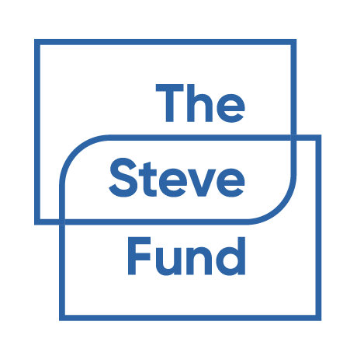
Example: “Happy” by Pharrell Williams

Slide 5
Discovering
Character Strengths
Character Strengths are positive parts of your personality that impact how you think, feel and behave.
Scientists have identified 24 character strengths that everyone has the capacity to express in different degrees. Here are a few examples.
Research shows that using your character strengths can help you improve your relationships, enhance health and overall well-being and buffer against, manage and overcome problems.
Bravery
Creativity
Gratitude
"I act on my convictions, and I face threats, challenges, difficulties, and pains, despite my doubts and fears."
"I am creative, conceptualizing something useful, coming up with ideas that result in something worthwhile."
“I am grateful for many things and I express that thankfulness to others.”
Hope
Humor
Kindness
“I am realistic and also full of optimism about the future, believing in my actions and feeling confident things will turn out well.”
"I approach life playfully, making others laugh, and finding humor in difficult and stressful times."
"I am helpful and empathic and regularly do nice favors for others without expecting anything in return."
Leadership
Love
Love of Learning
"I take charge and guide groups to meaningful goals, and ensure good relations among group members."
"I experience close, loving relationships that are characterized by giving and receiving love, warmth, and caring."
"I am motivated to acquire new levels of knowledge, or deepen my existing knowledge or skills in a significant way."
From VIACharacter.org, VIA Classification of Character Strengths and Virtues (Peterson & Seligman, 2004)
Interested in learning more? Take a free quiz to determine your personal character strengths profile at www.viacharacter.org
Perseverance
Spirituality
Teamwork
?
"I persist toward my goals despite obstacles, discouragements, or disappointments."
"I feel spiritual and believe in a sense of purpose or meaning in my life; and I see my place in the grand scheme of the universe and find meaning in everyday life."
"I am a helpful and contributing group and team member, and feel responsible for helping the team reach its goals."

Slide 6
Discovering
Knowing your strengths can help you be intentional in improving your well-being. Personal strengths can be defined as unique gifts or “aptitudes” that, when developed through practice, allow a person to master and demonstrate a particular skill.* Family strengths are relationship qualities that promote the well-being of the family as a whole.
Activity:
Consider the strengths below, and then click and drag any that you see in yourself and in your family to the boxes on the right. You can even write some of your own unique strengths!
Strengths I see in myself:
Individual Strengths
Family Strengths
Self-Motivation
Determination
Love & Affection
Communication
Courage
Persistence
Spirituality/Faith
Commitment
Open-Mindedness
Empathy
Belonging
Appreciation
Imagination
Positivity
Pride in Cultural Heritage
Mutual Respect
Strengths I see in my family:
Spirituality/Faith
Flexibility
Loyalty
Connection to Community
Athleticism / Physical Fitness
Resilience
Quality Time Together
Hopefulness
Write your own
Write your own
Write your own
Write your own
*From HIGH5TEST.com

Slide 7
Write your own
Write your own
Write your own
Write your own

Slide 9
Pinterest can be a great resource to search for and save images or quotes that inspire you. Sign in or create a free account and you can create inspiration boards, share them with friends, and even have them on your iPhone home screen for daily reminders.
Activity: Try making a Pinterest board with quotes or images that inspire you!
Daily Reminders
Set up a Pinterest widget on your home screen to cycle your inspiration board (or another’s public board that you love) throughout the day. Visit this page for instructions for iOS and Android devices.
Please note: boards have to be public in order to connect to the widget, so please ask an adult for permission first.

Slide 12
Interested in learning more? Learn more about the 5 Love Languages and related books at 5lovelanguages.com/learn

Slide 13
Interested in learning more? Learn more about the 5 Love Languages and related books at 5lovelanguages.com/learn

Slide 14
About

Slide 16
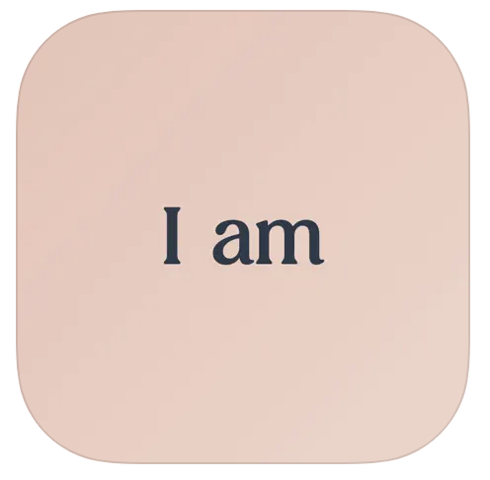
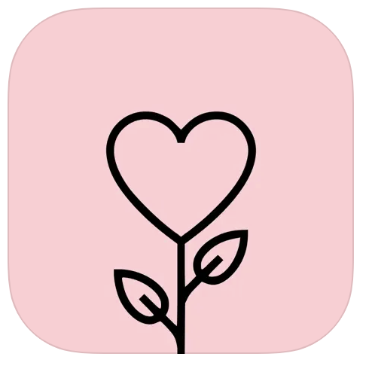
Recommended Reading
The Five Love Languages of Kids, by Gary Chapman & Ross Campbell, 5lovelanguages.com/store/the-5-love-languages-of-children
The Five Love Languages of Teenagers, by Gary Chapman, 5lovelanguages.com/store/the-5-love-languages-of-teenagers-2
Promoting Black Joy through Fun & Safe Digital Engagement from the National Black Child Development Institute, drive.google.com/file/d/1CYHZk41uY_5HuvvNQY67DreIWAp22RnH/view?usp=sharing_eil_se_dm&ts=66db275d
National Black Child Development Institute Virtual Resources www.nbcdi.org/virtual-event-resources/
“How Music Can Make Us Feel Good” from NAMI California, https://namica.org/blog/music-that-makes-us-feel-good-playlist/#:~:text=Many%20bodies%20of%20research%20support,and%20lower%20our%20stress%20levels
Take a free quiz to discover your character strengths by using the VIA Character Strengths Survey, viacharacter.org/
Wellness Apps
I Am - Daily Affirmations
Headpsace: Sleep & Meditation
Gratitude - Journal Prompts
Connect with The Steve Fund
stevefund.org
Knowledge Center
The Steve Fund on Instagram
The Steve Fund on Youtube
The Steve Fund on X
Email: info@stevefund.org
Contact a Helpline
Stressed, depressed, or anxious? Text STEVE to 741741 to connect with a trained crisis counselor 24/7
24/7 Suicide and Crisis Lifeline: Call or text 988, 988lifeline.org
Coloring can be a relaxing and stress-reducing activity. On the next few pages are coloring sheets you can print out and enjoy.

Slide 17
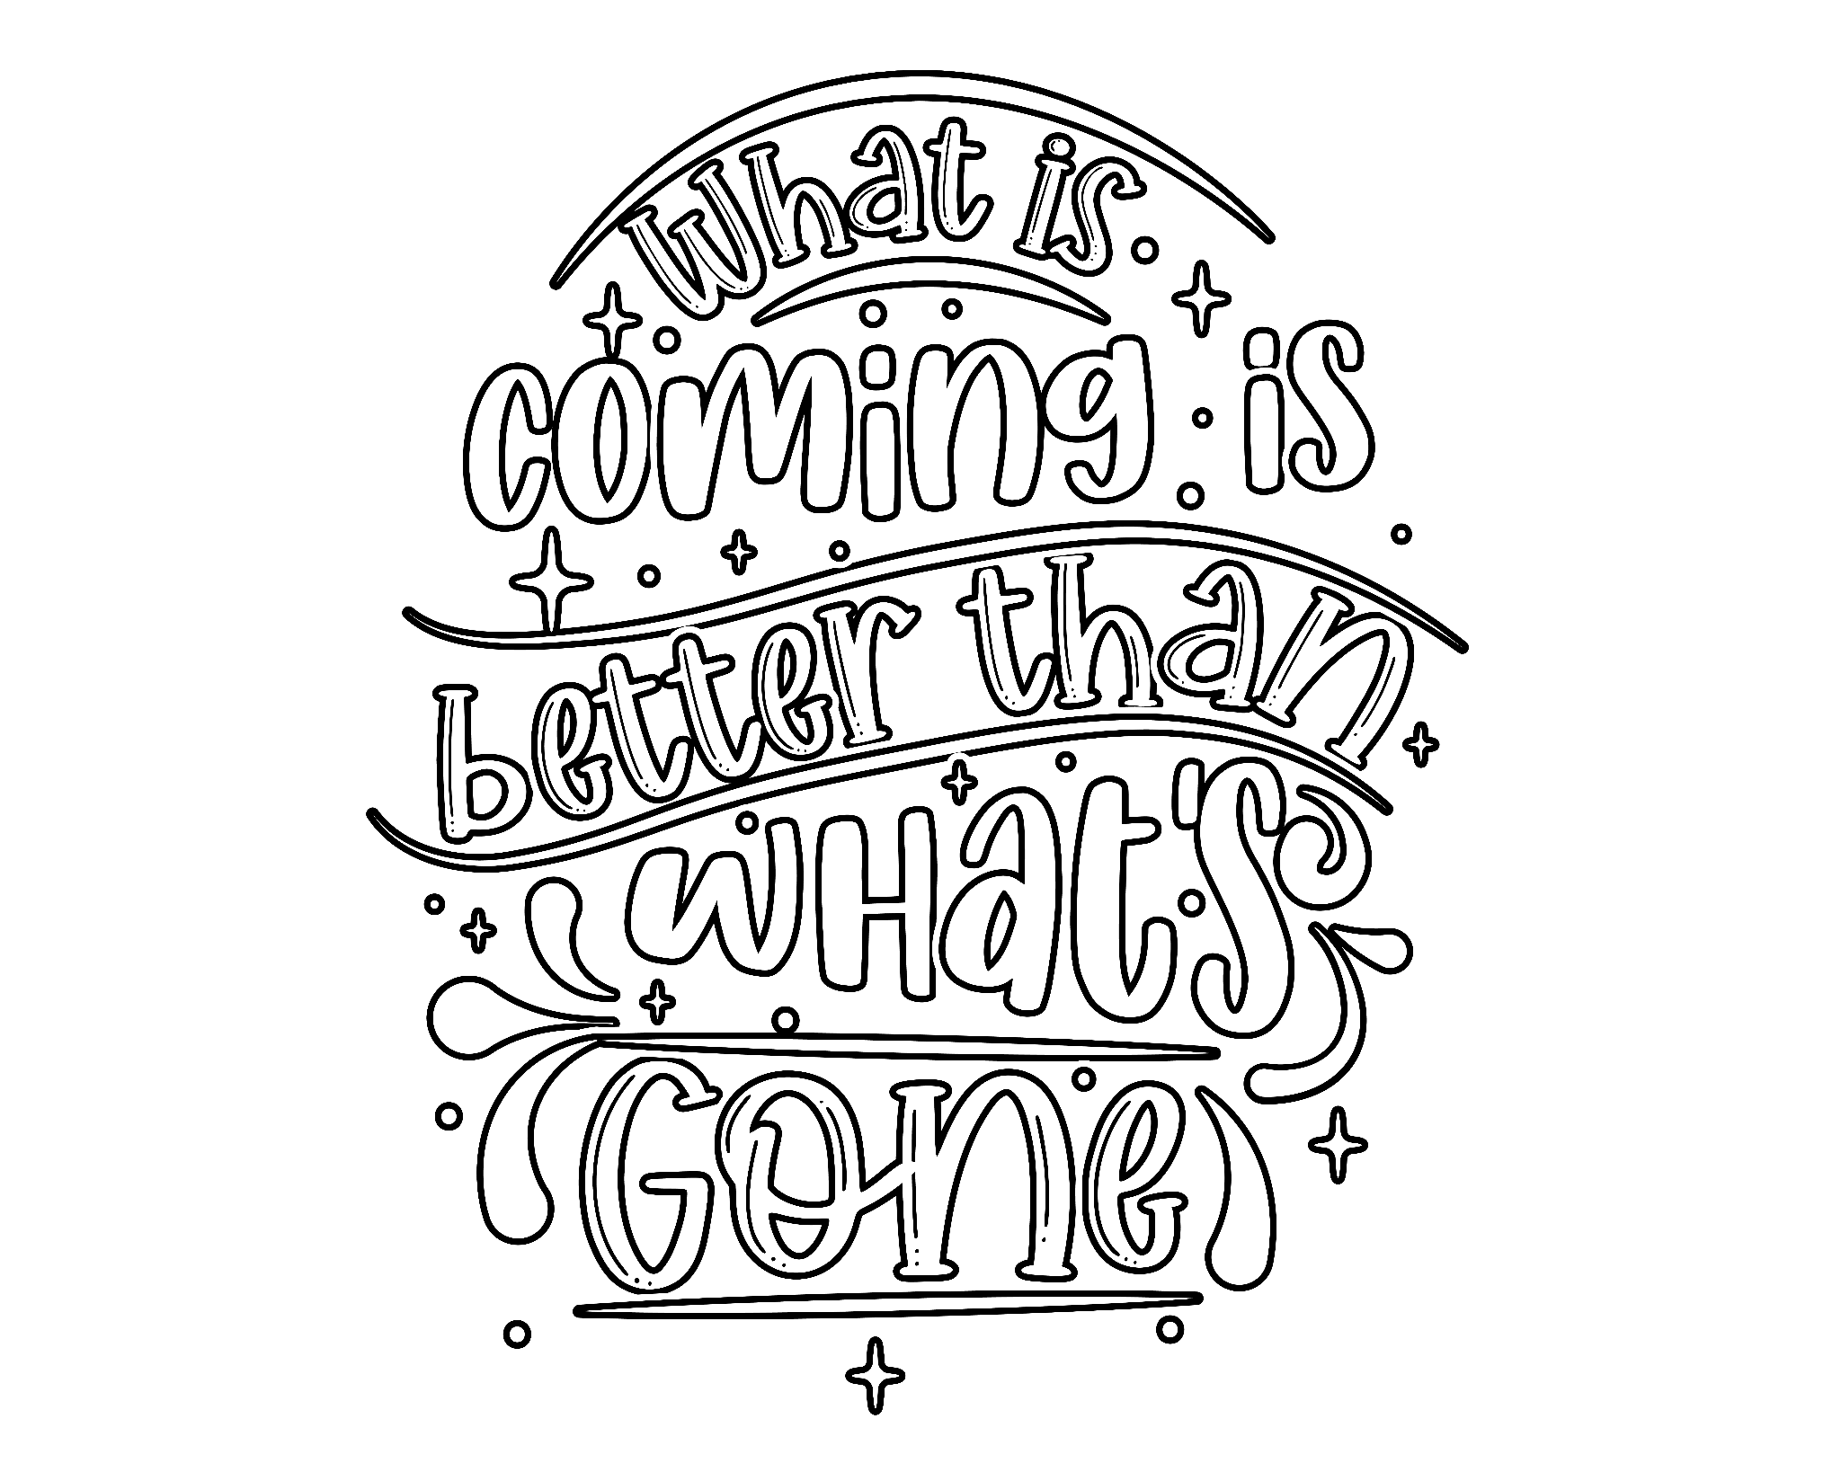

Slide 20
